Slide 1
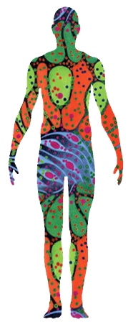
HuBMAP Data Processing Pipelines
Jack Lasota
Pittsburgh Supercomputing Center (PSC)
Carnegie Mellon University / University of Pittsburgh

Slide 2
Overview
Outline, Background of HubMap (or PSC/Ruffalo lab?) (~2)
Quick tour of HuBMAP Consortium Portal (~2)
Data processing pipeline (~2 Penny on scRNAseq, one workflow, one on results?)
User interface

Slide 3
Introduction
Objective: Build pipelines for large-scale biological data and provide accessible tools with spatial maps.
Standardization: Uniformly process multimodal data from all tissue mapping centers.
Tools: Use Python (Jupyter) and domain-specific libraries for analysis.
Environment: Run pipelines on UNIX systems for high-throughput processing.
Data Products: Combine all datasets by assay and tissue.

Slide 4
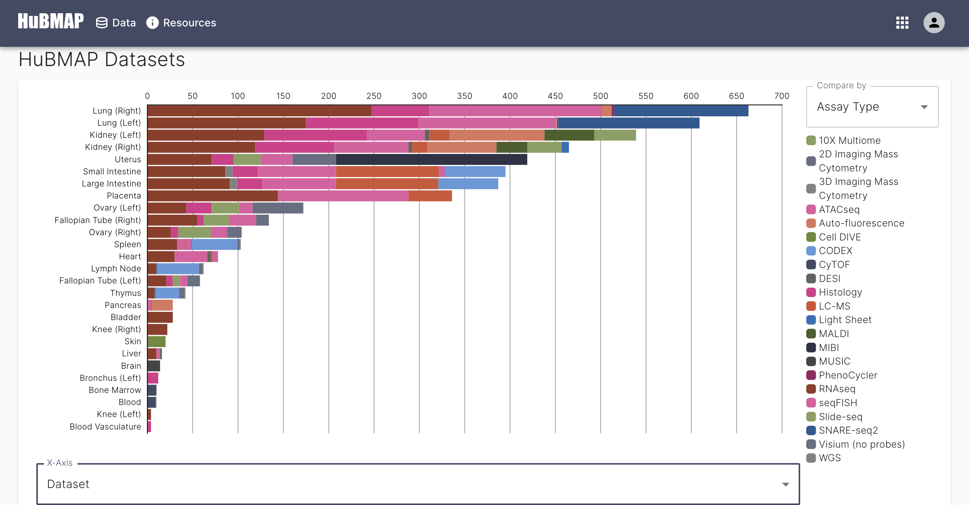
HuBMAP Consortium Data Portal
Data Portal: Centralized access to datasets with tools for analysis and visualization.
Discovery: Search or browse by organ, cell type, or molecule.
Visualization: Interactive tools for spatial and single-cell data.
Access: Download raw and processed datasets.

Slide 5
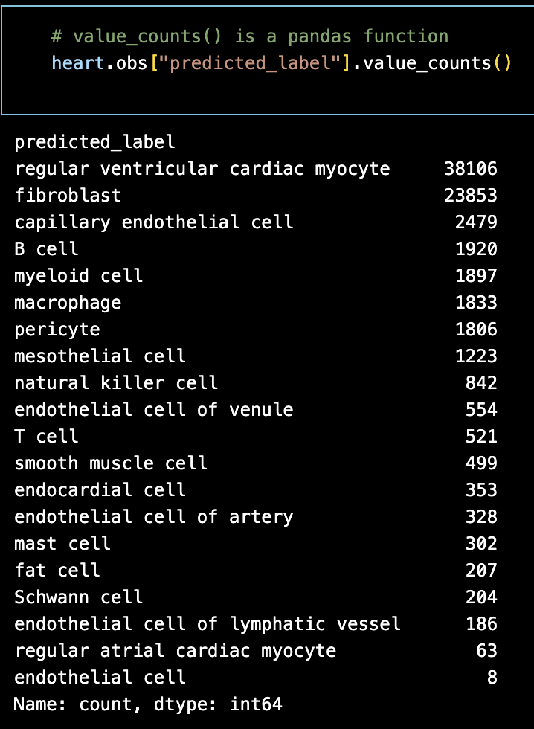
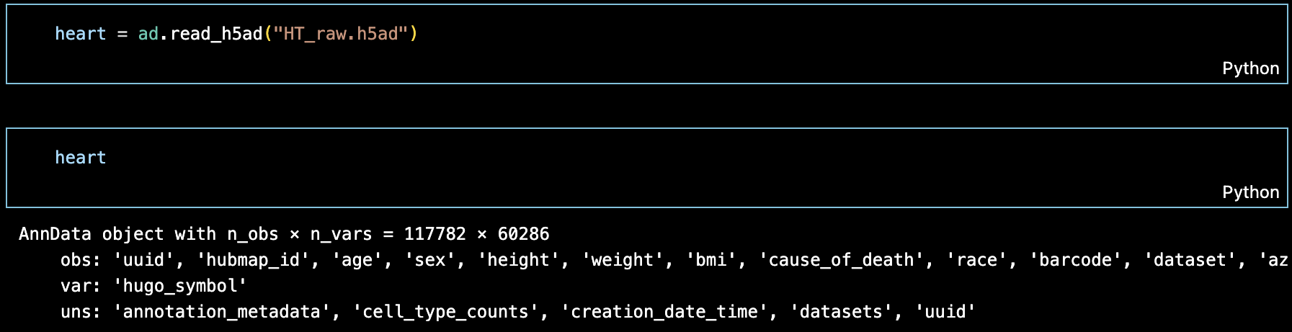
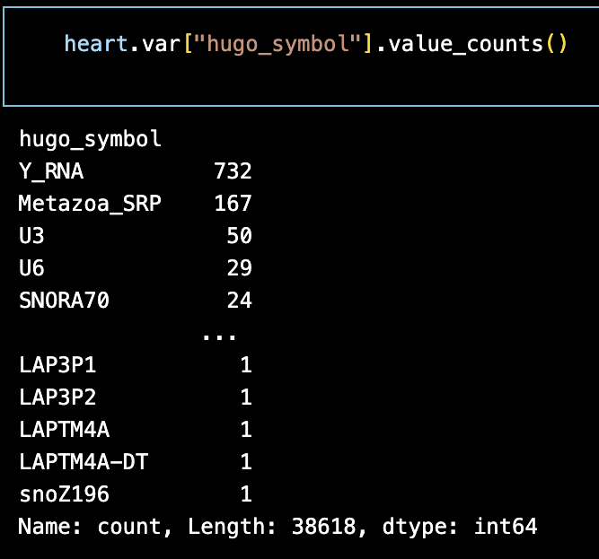
Raw Heart Data - scRNAseq
z
HuBMAP raw heart data was read using the AnnData Python package, which provides tools for interpreting and working with complex biological datasets.
The pandas library enables targeted analysis of specific data points.

Slide 6
Scanpy
Scanpy is a Python toolkit for analyzing large single-cell gene expression datasets.
Pre-processing: quality control and filtering of cells and genes.
Clustering: identifies cell groups based on gene expression profiles.
Visualization supports tools like UMAP to explore high-dimensional data.
Differential expression detects genes varying between cell populations.
Integration is compatible with other Python libraries for extended workflows.

Slide 7
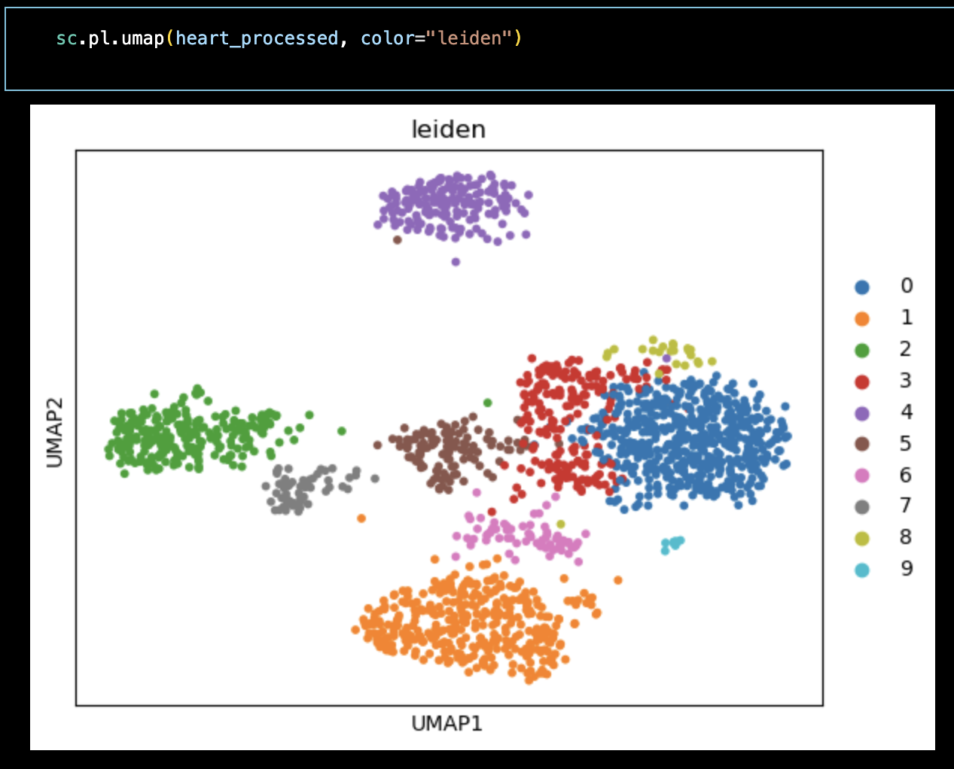
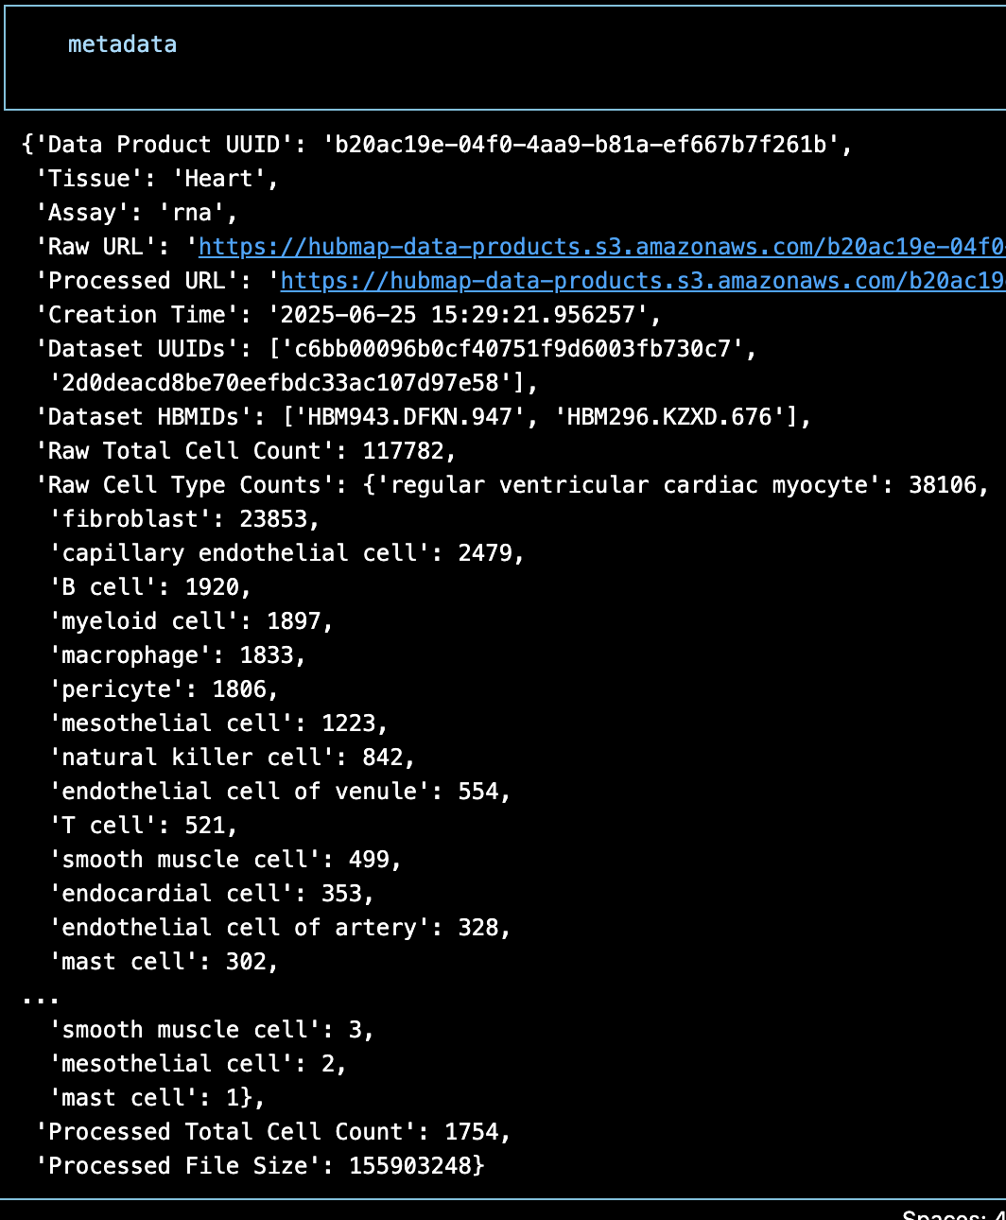
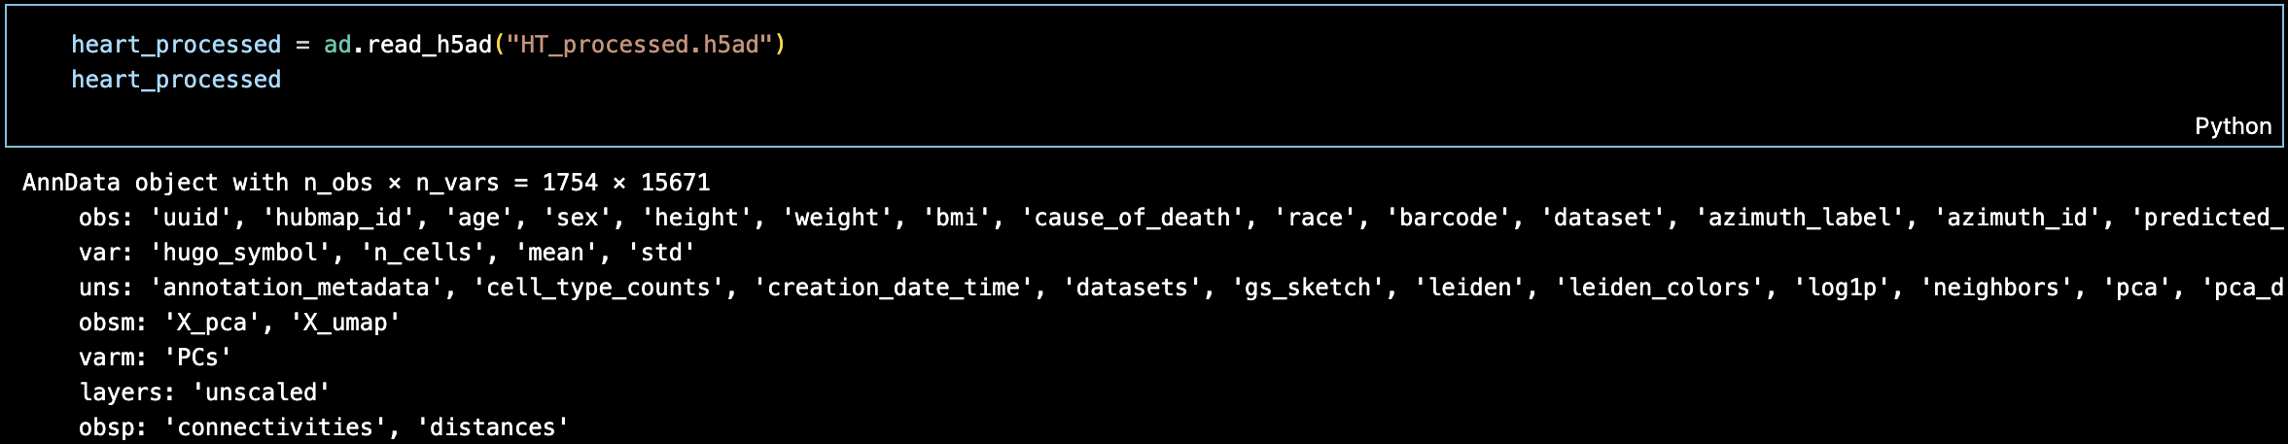
Processed Heart Data – Pipeline Results
After processing, about 99% of cells and 75% of genes were filtered out.
Pipeline utilizes Leiden clustering, viewed with UMAPs plotted by scanpy.
Metadata gives an overview of the data set.

Slide 8
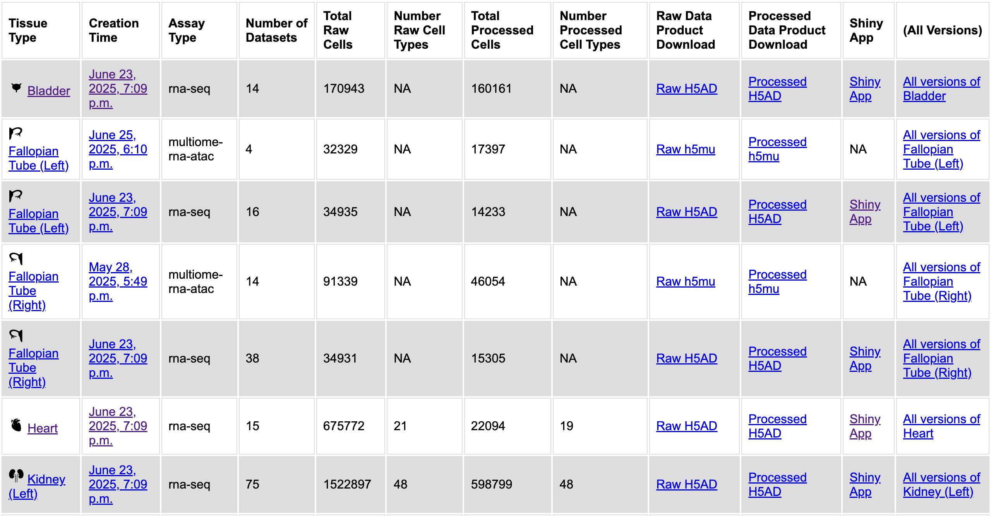
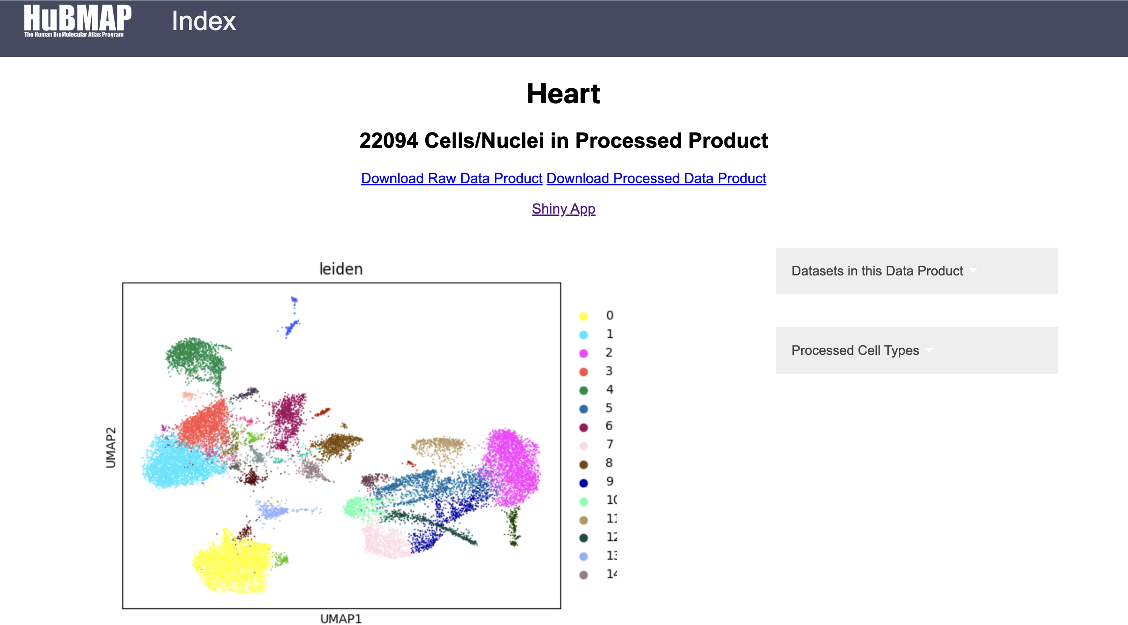
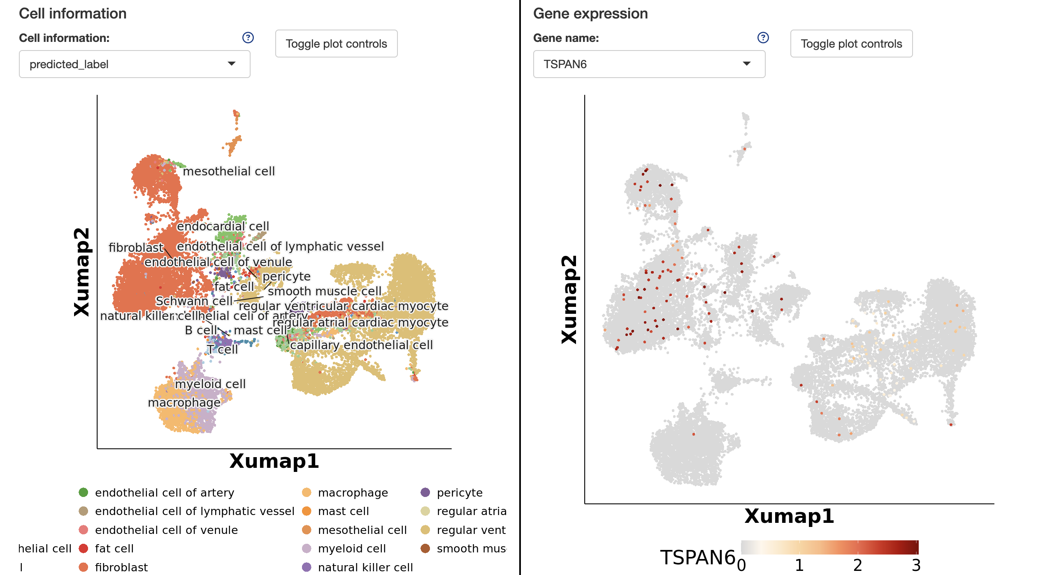
User Interface
Metadata is integrated into the user interface, with tissue type overviews provided. Shiny app enables both gene and cell-level insights/comparisons.

Slide 9
Team
Nick Nystrom (PI, PSC): PSC Chief Scientist Jonathan C. Silverstein (PI, Pitt): Professor and CRIO, DBMI

